Slide 1
Shelf Care: What Libraries Can Do to Support Caregivers
Kelly G. Loeb, MSW
Community Engagement Coordinator
KU Alzheimer’s Disease Research Center
Thursday, September 12, 2024

Slide 2
The Human Brain as a Card Catalog Check it Out: The Breakfast Club Dewey Dare? How and Why: Rolling Out the Red Carpet across Kansas A Boom in Zoom Rooms: Taking Technology to Town There’s an App(endix) for that!
Table of Contents

Slide 3
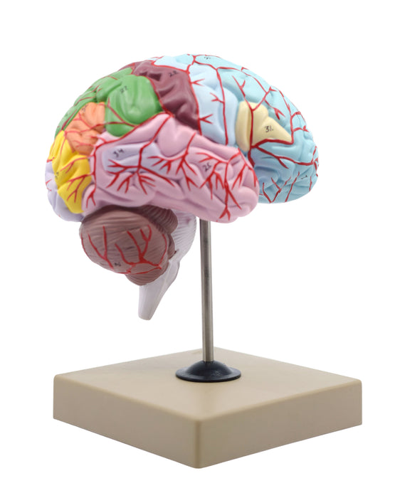
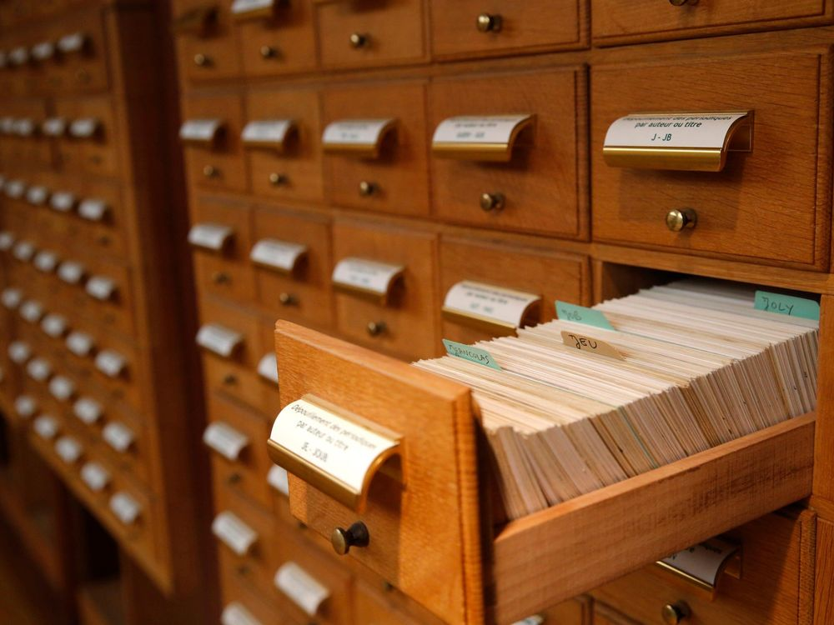
The Human Brain as a Card Catalog
Lobe, Cerebellum, Cerebrum, Hippocampus, and Hypothalamus, oh my!
Aaron Burr, sir to Zyxin protein

Slide 4
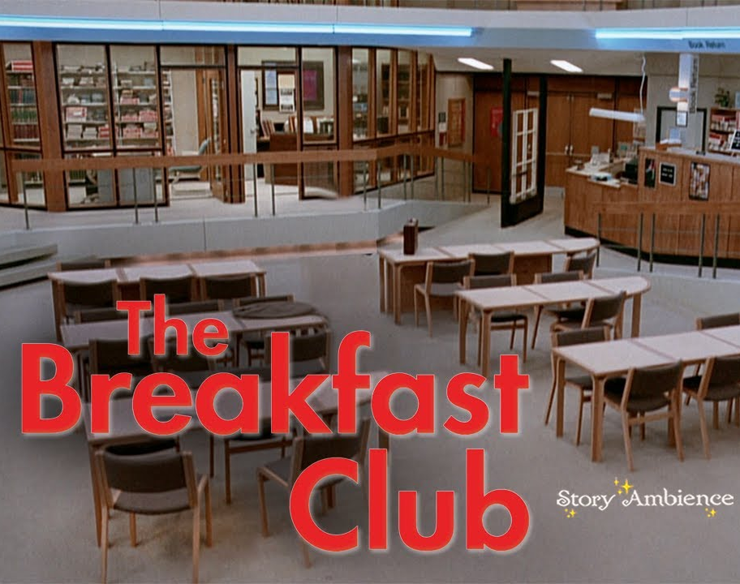
Helping caregivers check in so they can (and will) check out support
From a diner in Parsons, KS to the urban core of Kansas City, MO: if you feed them, they will come
Established Saturday, July 13, 2002 and is still ongoing!

Slide 5
Dewey Dare? How and Why We’re Rolling the Red Carpet across Kansas
362.6 | Older Adults
616.8311 | Dementia
649.8 | Caregiving

Slide 6
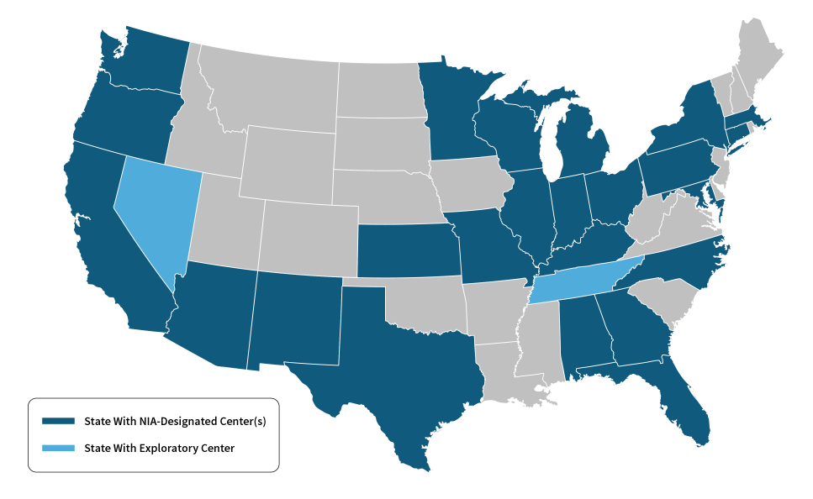
A Boom in Zoom Rooms: Taking Technology to Town
KU ADRC is one of 35 such institutes in the U.S.
Kansas: (Woodson County population is 25% age 65+; Maine is the state with the most older adults per capita: 22.5%)
Geriatric healthcare desert and an oasis
KC metro/Wichita/Topeka + the rest of the state?
Family Series
Cognitive Care Network
Why (Hoisington, KS)

Slide 7
There’s an App(endix) for that!
MyAlliance for Brain Health (joinmyalliance.com)
Why film – kuadrc.org/WHY
Dementia CareAssist App
Research Participation: Avocados and hot tubs and red wine!
Speaking of Smell: the AROMA study

Slide 8
No holds, no overdue fees, unlimited renewals:
Thank you for the work you do as
libraries transforming minds!
I have always imagined that Paradise will be a kind of library.
–Jorge Luis Borges
The only thing you absolutely have to know is the location of the library. – Albert Einstein
Fin.

