Slide 1
the aging brain
Maritza Buenaver, MD
Geriatric Psychiatry/ Hospice and Palliative Care
Oklahoma City Veterans Administration Health Care System
September 2024

Slide 2

objectives
To learn about normal brain function and brain changes with aging
To differentiate between normal and abnormal brain aging
To familiarize with the 4 most common types of dementia and their characteristics
To differentiate between modifiable and non modifiable risk factors of cognitive decline
To learn 10 steps for healthy aging
To learn tips for communication with people with dementia
To familiarize how libraires can help people with dementia

Slide 3
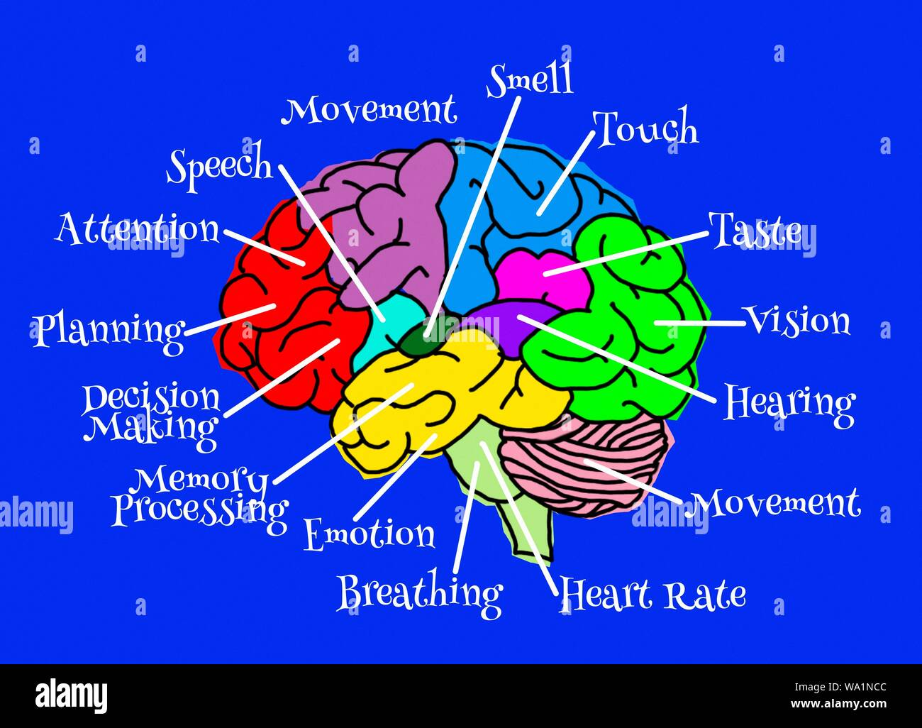
Normal brain function

Slide 4
Normal Brain Aging
Everyone’s brain ages, but it’s not what most people think.
FACT: until you are up in your 90s, you lose less than 10 percent of the cells in your brain.
Why do we see shrinkage of the aging brain?
Brain cells change in their structure: become smaller, they may shrink but not die.
Blood flow may decrease.

Slide 5


Cognition and normal aging
Peak at 30 years of age
Normal decline:
Processing speed is slower: takes longer to acquire new information
Takes longer to retrieve information
Slower to find words and recall names
Not all thinking abilities decline with age.
Vocabulary, reading and verbal reasoning remain unchanged or even improve during the aging process.

Slide 6
Carol Barnes, Ph.D.
Neuroscientist studying aging, found that even though those cells are shrinking, their effectiveness is increased.
The connections are boosted between the cells so they can maintain a lot of their function even though they get smaller.
Dr. Barnes’ studies concluded 2 major findings.

Slide 7

Two major findings in her studies
One is that many of these connections become stronger. They’re compensating for the loss of the numbers of connections between cells.
Sometimes the cells/connections misfire: The way cells communicate with each other might be a little bit more hit-or-miss.

Slide 8
Good News
IT IS POSSIBLE TO REGENERATE BRAIN CELLS
Another positive fact about the aging brain is that you are still producing new cells as you get older. Right up until the time you die.
As far as we know, the brain can to some extent, regenerate itself.
We don’t know enough about how to make it happen faster. Although there is some suggestion that exercise and learning can increase neurogenesis, even in elders.

Slide 9

Where on Earth are those glasses?

Slide 10
What is abnormal aging of the brain?
Symptoms to watch for:
Difficulty expressing oneself in conversation
Rapid forgetting
Getting lost in familiar places
Repetitive questioning
Odd or inappropriate behaviors
Forgetfulness of recent events
Repeated falls or loss of balance
Personality changes
Decline in planning and organization
Changes in diet/eating habits
Changes in hygiene
Increased apathy
Changes in language abilities, including comprehension

Slide 11

Dementia
Alzheimer’s
Lewy Body
Frontotemporal
Mixed Picture
Drugs
Vascular
TBI
Alcohol
CJD
Mental illness
Parkinson’s

Slide 12

Most common types of Dementia
Alzheimer’s
Vascular
Lewy Body
Fronto/ temporal

Slide 13

.
Progressive
Irreversible
IADLS - teenage years
  Finances
  Transportation
  Shopping
  Cooking
  Communication devices
  Medication management
  Housework
BADLS - childhood
  Transferring
  Bathing
  Grooming
  Dressing
  Feeding
  Toileting

Slide 14


Alzheimer’s disease

Slide 15

Vascular (Multi-infarct Dementia)

Slide 16
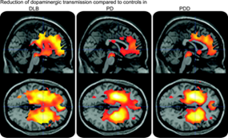
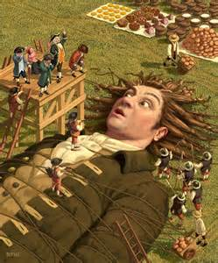
Lewy Body Dementia
Notes:
\

Slide 17
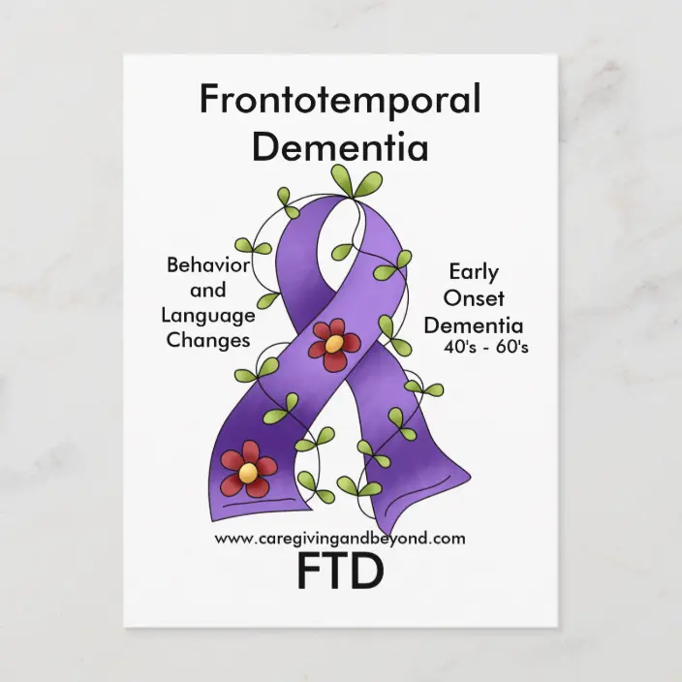

Slide 18
Most Common types of dementia and charactristics
Dementia type | Onset /characteristics
Alzheimer’s disease | Slow insidious/ poor memory /cortical
Vascular | Step wise or sudden/ sporadic memory, misinterpretation
Lewy body | Slow with Parkinson's like and hallucinations/ subcortical
Fronto temporal | Changes in personality, inappropriate/ speech problems/good memory /frontal and temporal lobes

Slide 19

Virtual Reality: Beatriz Lab
A Journey Through Alzheimer’s Disease
Early Stage and Middle Stage
Immersive Training
Embodying Beatriz

Slide 20
Risk Factors for Cognitive Decline
Modifiable
Non modifiable
Type 2 diabetes
High blood pressure
Midlife obesity
Smoking
Depression
Little or no mental activity
Little or no physical exercise
Age
Genetics

Slide 21
10 Steps for Healthy Aging

Slide 22
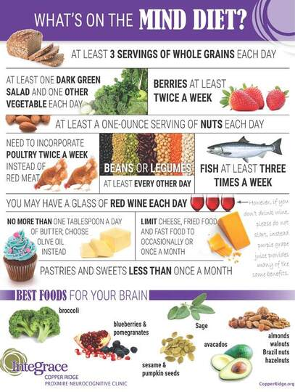
1) Eat well

Slide 23
Should we or should we not
More and more herbal remedies, dietary supplements, and "medical foods" are promoted as memory enhancers or treatments.
Some even claim they can delay or prevent Alzheimer's disease and other dementias.
A growing body of evidence suggests that eating a healthy diet may lower the risk for cognitive decline and dementia.
However, not a single food, beverage, ingredient, vitamin or supplement has been proven to prevent, treat or cure Alzheimer's disease or to benefit cognitive function or brain health.

Slide 24
supplementation
Caprylic acid and coconut oil
Coenzyme Q10
Coral calcium
Ginkgo biloba
Huperzine A
Omega-3 fatty acids
Phosphatidylserine
Lion’s mane mushroom
MCT oil--Medium chain triglyceride

Slide 25
2.) Stay active
Physical activity increases blood flow to the brain and can also help improve mood and overall wellbeing.
Brisk walking benefits brain health, while aerobics can boost your heart rate, and weight training builds strength and flexibility.

Slide 26
3.) Learn new things
Challenge your brain by starting a new hobby like playing tennis, learning to speak a foreign language, trying a cooking class, or something you haven’t done before.
Even something as simple as brushing your teeth with your non-dominant hand stimulates the brain by forcing it to think outside of its normal routine.

Slide 27

4.) Get enough sleep
  Getting a consistent sleep every night is key; at least 7-9 hours is ideal.
  Having a good sleep environment is also helpful.
  Insomnia or sleep apnea can have serious physical effects and negatively affect memory and thinking.

Slide 28

5.) Mind your meds
  Medication can affect everyone differently, especially as you age.
  When getting a new medication or something you haven’t taken in a while (whether over the counter or prescription), talk to your doctor or local pharmacist.

Slide 29


6.) Stop Smoking and Limit Alcohol
  Smoking can increase the risk of other serious illnesses, while too much alcohol can impair judgment and cause accidents, including falls, broken bones, and car crashes.

Slide 30

7.) Stay connected
  Social interaction and maintaining an active social life are very important for brain health, cognitive stimulation and mood.
  Invite friends and family over for a meal, board games, or just to hang out. Engaging in your community and participating in group activities is also beneficial.

Slide 31

8.) Know your blood pressure
  Blood pressure can impact your cognitive functioning.
  Visit your physician regularly to check your blood pressure and make sure it is in normal range.

Slide 32

9.) See your doctor
  Maintain checkups. Health screenings are key to managing chronic illnesses, such as diabetes, cardiovascular disease, and obesity, all of which can impact brain health.
  Speak with your physician about any concerns or questions you have about your health.

Slide 33

10.) Get a memory screening
  Our brains need regular checkups, just as other parts of our bodies do.
  A memory screening is a quick, easy, non-invasive exam for our brains.

Slide 34
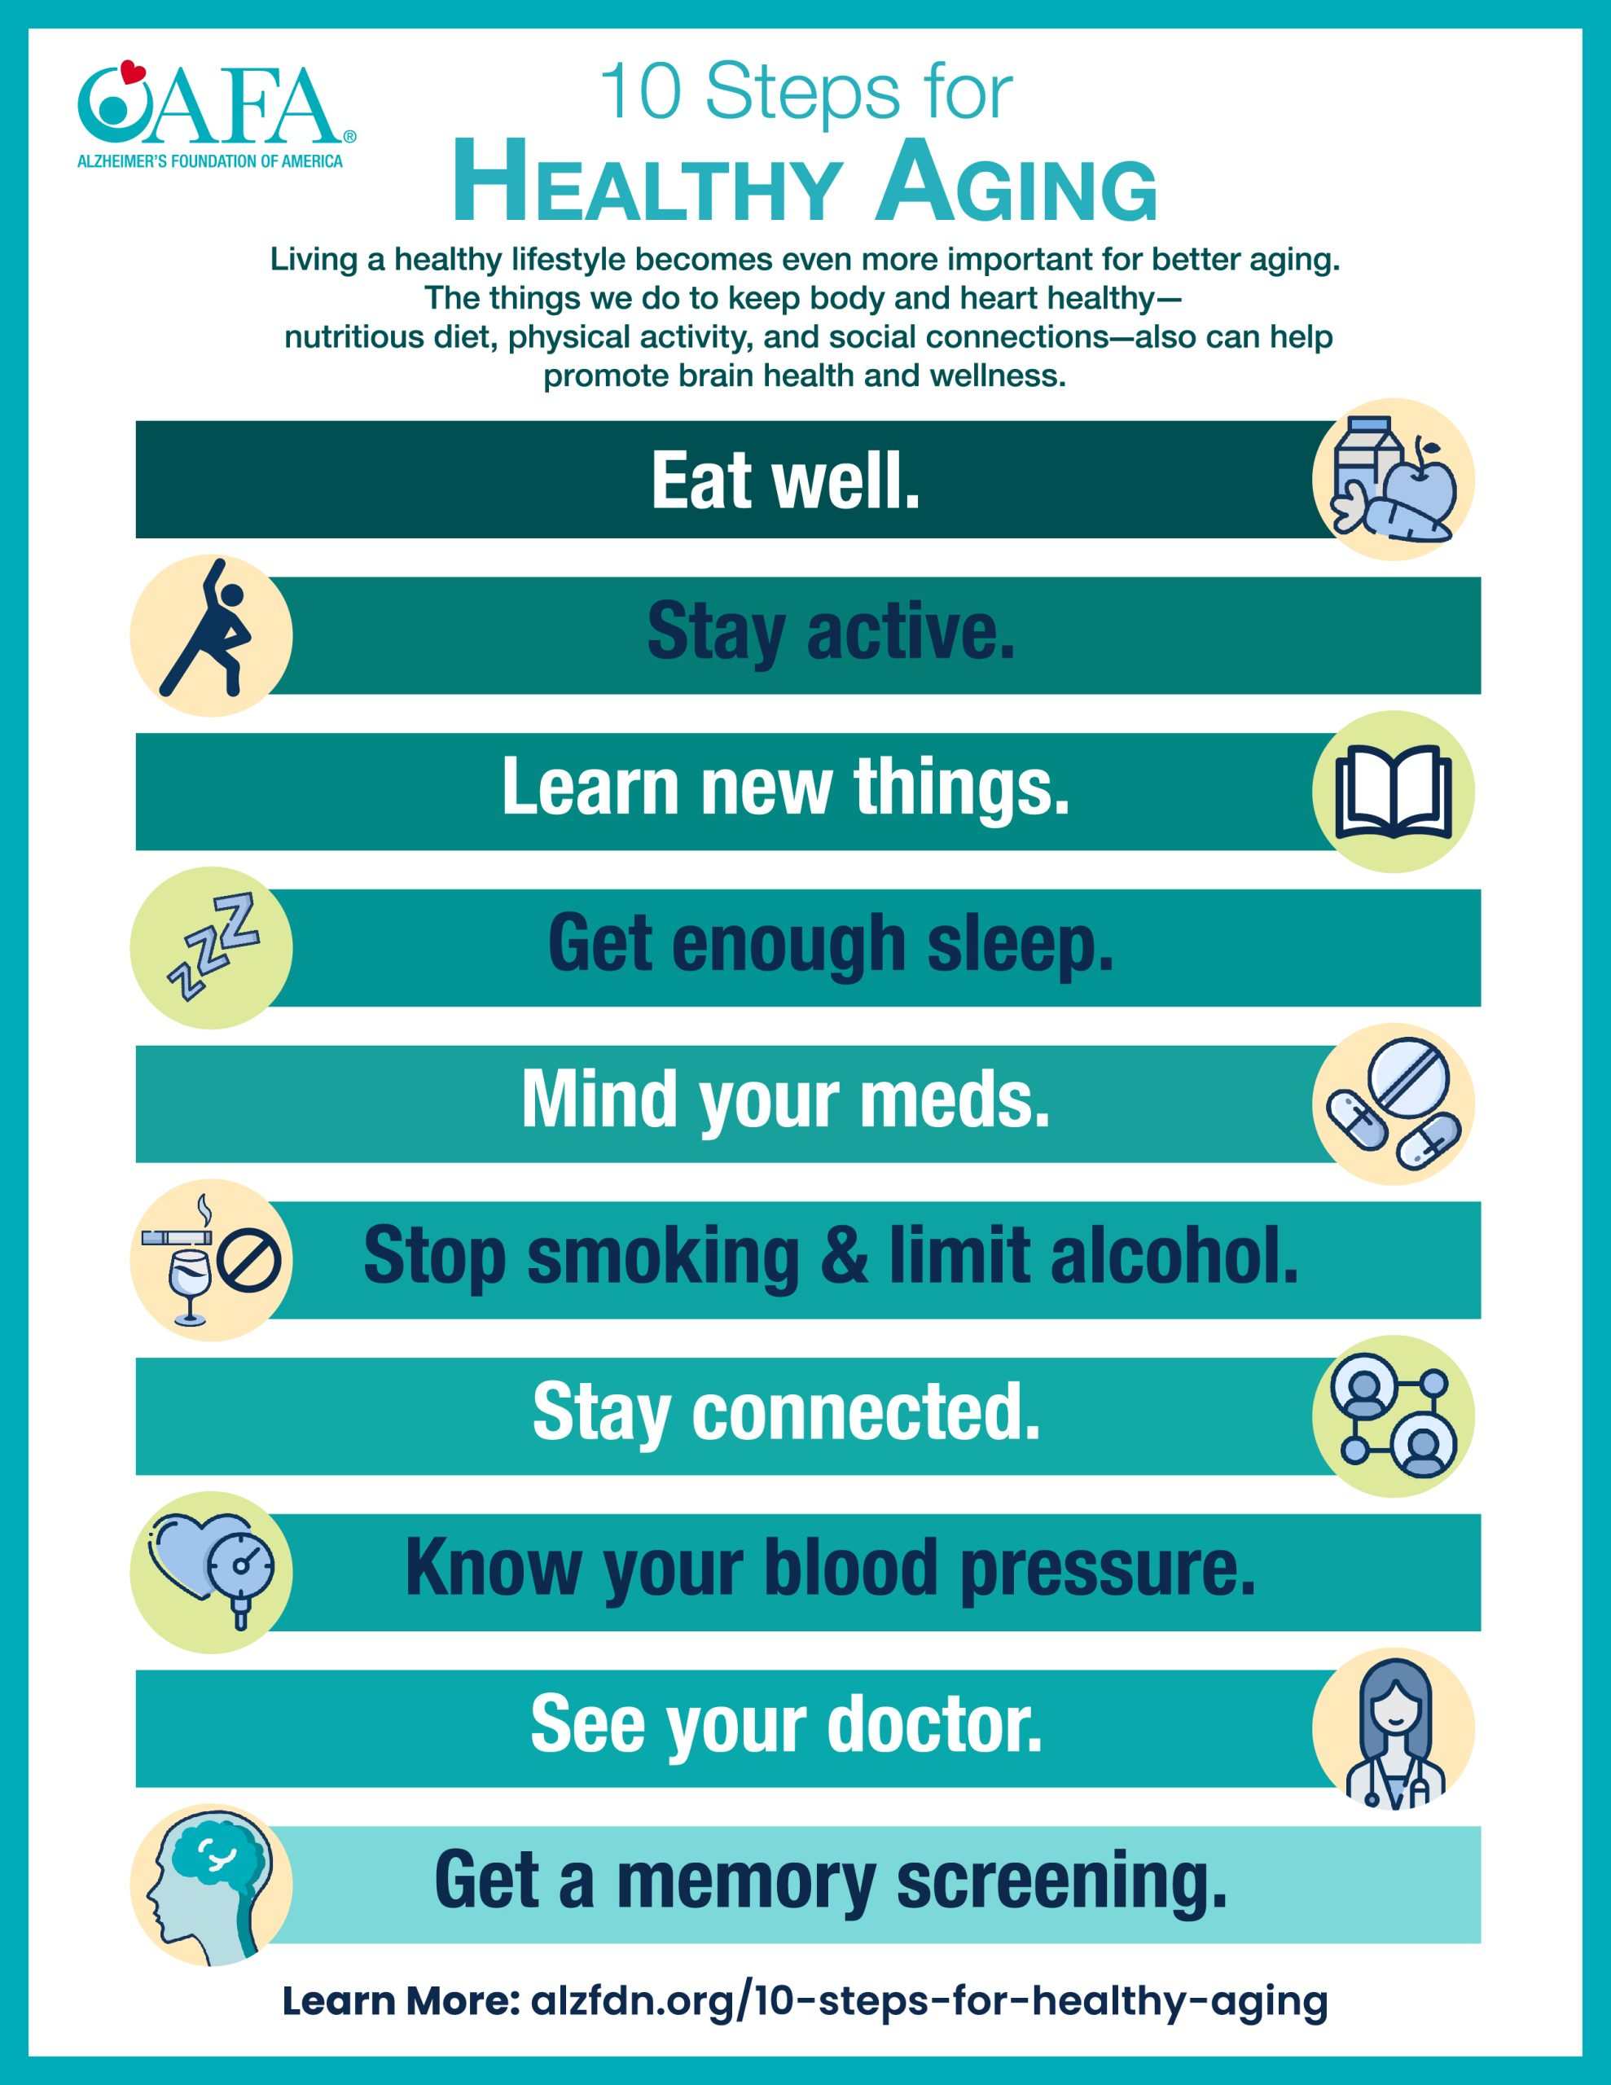

Slide 35
Communication
Takes 2
Sending and receiving
Verbal:
Listening and speaking
Non Verbal

Slide 36
Interacting with People with Dementia
Speak clearly and be patient
Listen closely
Smile warmly and make eye contact
Respond to a look of distress
Help when confusion is present
Watch for signs of change and offer help

Slide 37
Dementia
Related Behaviors
Have meaning and purpose
Communicating a need or emotion:
Frustration?
Responding to their needs/ communication
What are they trying to tell us? Actions?
Don’t take it personal
Unmet needs?

Slide 38

Libraries can help people with dementia in many ways, including:

Slide 39
1. Socializing to avoid social isolation:
Book groups, which can promote empathy, belonging, and civic participation
Memory cafes, which can help people reminisce and tell stories.
Creative activities can also help people with dementia and their caregivers participate together, even if the activity doesn't rely on skills like memory or verbal communication to create meaningful engagement or work with community partners to bring music, art, or poetry programming to the library.

Slide 40
2. Dementia collections:
libraries can provide dementia collections with materials like puzzles, photobooks, and tools to keep the mind active and provide stimulation.
Some libraries also offer dementia care kits, which can include reminiscing kits, sensory kits, and activity kits.
Notes:
Libraries can help people with dementia in many ways, including:

Slide 41
3. DEMENTIA-RELATED TITLES:
LIBRARIES CAN OFFER BOOKS AND OTHER MATERIALS RELATED TO DEMENTIA.
Audio books in both CD and downloadable format.
Magazines in both paper and downloadable format.
Music in both CD and downloadable format
Videos in both DVD and downloadable format

Slide 42
4. DEMENTIA AWARENESS TRAINING:
Provide
Dementia awareness training for staff.
Host
Educational sessions for the public about dementia.
Provide
Assistive technologies for patrons.

Slide 43
5. Dementia-friendly environments:
Small changes in a physical space can make a big difference
Entrances should be clearly visible and understood as an entrance. Make sure that glass doors are clearly marked.
Signage for finding your way around should be clear, should use bold type, and should have contrast between the words and the background.
Lighting at entrances should be high powered and include natural light when possible. Avoid pools of bright light and deep shadows.
Flooring should be plain, not shiny, and not slippery. Pathways should be wide and free of clutter.
A family/unisex restroom will allow someone to be assisted without causing embarrassment to them or another user.

Slide 44
Positive Physical Approach

Slide 45
Resources in the community
www.actonalz.org/engagement
www.actonalz.org/dementia-friends
Visit the Alzheimer’s and Related Dementia’s Interest Group (IGARD), Association of Specialized and Cooperative Library Agencies (ASCLA),American Library Association (ALA) website for more information about providing library services to people living with dementia
www.ala.org/ascla/interestgroups/igard

Slide 46

Referrals
Local Agency on Aging
www.alz.org
nihseniorhealth.gov/category/healthyaging.html
cdc.gov/physicalactivity/basics/olderadults

Slide 47
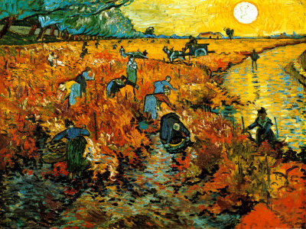
Discussion
http://www.vangoghgallery.com/painting.Vincent Van Gogh. The Red Vineyard at Arles, c.1888

