Slide 1
Welcome to the Library Board… Now Meet with a purpose!
Trustee Training 2019

Slide 2
Objectives for Today
Understand process for selecting board members.
Know your role and how to partner with the library director for success.
Identify key elements of board orientation.
Understand how to structure board meetings for optimum flow and impact.
Answer your questions, frequently asked and otherwise!

Slide 3
How you arrived on the board . . .

Slide 4
How you arrived on the board . . .
K.S.A. 12-1222. City, county and township libraries; board; appointment; terms; eligibility; vacancies; expenses.
. . . . the official head of a municipality shall appoint, with the approval of the governing body, a library board for such library.
. . . . each member shall serve for a term of four years.
. . . . In addition to the appointed members of the board the official head of the municipality shall be ex officio a member of the library board with the same powers as appointed members, but no person holding any office in the municipality shall be appointed a member while holding such office.

Slide 5
How you arrived on the board . . .
K.S.A. 12-1222. cont.
. . . . All members appointed to a library board shall be residents of the municipality.
. . . . Vacancies occasioned by removal from the municipality, resignation or otherwise, shall be filled by appointment for the unexpired term.
. . . . No person who has been appointed for two consecutive four-year terms to a library board shall be eligible for further appointment to such board until one year after the expiration of the second term.

Slide 6
Exceptions . . .
District Library board members are elected.
County libraries vary too.
The governing body of any CITY may, as an alternative . . . appoint 10 members to the city library board.
CITIES have broad powers to “charter out” of certain portions of library statute. Examples include:
Number of board members from 7 to 10.
Additional board members may be residents from outside City limits.
Mill levy caps.

Slide 7
We have a quorum, right?
Library Type | # of board members | # for a Quorum
City | 7 + Mayor = 8 | 5
District | 7 | 4
Township | 5 + Township Trustee = 6 | 4

Slide 8
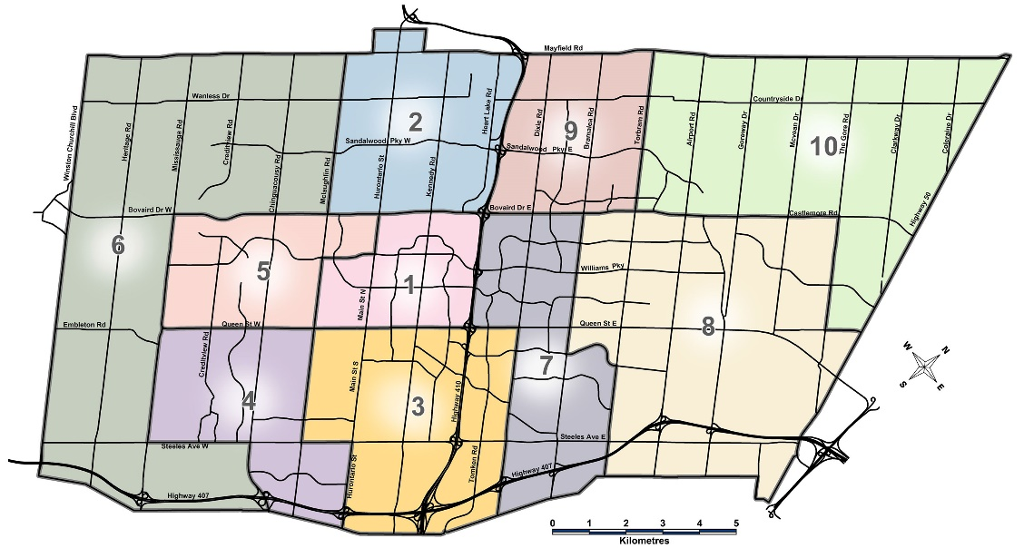
Board composition . . .
Geography
Skills
Interests

Slide 9
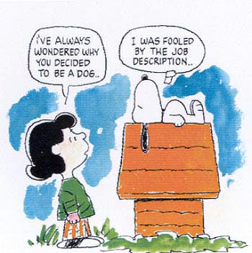
What’s my job?
Don’t leave it to chance . . .
Provide interested individuals with a written job description!

Slide 10
Board roles . . .
Be informed; attend meetings
Hire and evaluate the library director
Monitor and evaluate the overall effectiveness of the library
Set library policies
Review and adopt the annual budget
Develop long-term library plans – Strategic Planning!
Advocate for the library
Communicate regularly with the library director
Conduct the affairs of the board at regularly scheduled meetings
Keep the doors open

Slide 11
director roles . . .
Create budgets
Hire, coach and evaluate staff
Develop long-term library plans – Strategic Planning!
Implement strategic plan
Organize work of the library
Advocate for the library
Communicate regularly with the library board
Community outreach
Provide library services to patrons
Keep the doors open

Slide 12
Board orientation . . .
Written new member packet
bylaws;
annual budget and recent monthly budget report;
meeting minutes for current year;
roster of board members;
current year calendar; etc.
Meetings with library director and board chair
Tour and introductions

Slide 13
Board meeting prep . . .
Setting the agenda
Distributing board member packets
Reviewing packets prior to meeting
Meeting attendance

Slide 14
Board meeting . . .
Begin on time
Let “rules of order” be your guide
Use a consent agenda
Get to the good stuff

Slide 15
intermission

Slide 16
Model board meeting . . .
Let us entertain you!

Slide 17
Board meeting discussion . . .
Surprises?
Concerns?
Key takeaways?

Slide 18
Board meeting encore . . .
Special meetings
Advertising meetings
“Notify Me” list
Roles of board officers
How to write and post minutes
Your questions?

Slide 19
Questions . . . frequently asked and otherwise!
What is the origin of standard calling for 65% of annual budget to be spent on staff expenditures (salaries & benefits)? What is the logic here?
What are some ways that other libraries have worked cooperatively with the local government to promote economic development?

Slide 20
Questions . . . frequently asked and otherwise!
Who should sign checks?
In the case of a tie vote, who breaks the tie? Is the board president allowed to vote otherwise? Does it take a majority of those present to approve something, or a majority of the entire board?

Slide 21
Questions . . . frequently asked and otherwise!
?

